Slide 1


Microprocessors and Assembly Language Spring 2020
Hamed Farbeh
farbeh@aut.ac.ir
Department of Computer Engineering
Amirkabir University of Technology
Lecture 14

Slide 2
Copyright Notice
Parts (text & figures) of this lecture are adopted from:
Arm Assembly Language Programming and Architecture, Volume 1, 1st edition, Muhammad Ali Mazidi, Sarmad Naimi, and Sepehr Naimi, MicroDigitalEd, 2013.
Microprocessors and Assembly Language, Spring 2020, AUT, Tehran, Iran

Slide 3
Why to Learn Assembly Language
HLL can greatly enhance programmer productivity, BUT
Writing assembly code is desirable or necessary for
The first steps in booting the computer
Code to handle interrupts
Low-level locking code for multi-threaded programs
Code for machines where no compiler exists
Code which needs to be optimized beyond the limits of the compiler
On computers with very limited memory
Code that requires low-level access to architectural and/or processor features
Write a compiler
Program device drivers
Microprocessors and Assembly Language, Spring 2020, AUT, Tehran, Iran

Slide 4
ARM Architecture and Assembly Language Programming
Microprocessors and Assembly Language, Spring 2020, AUT, Tehran, Iran

Slide 5
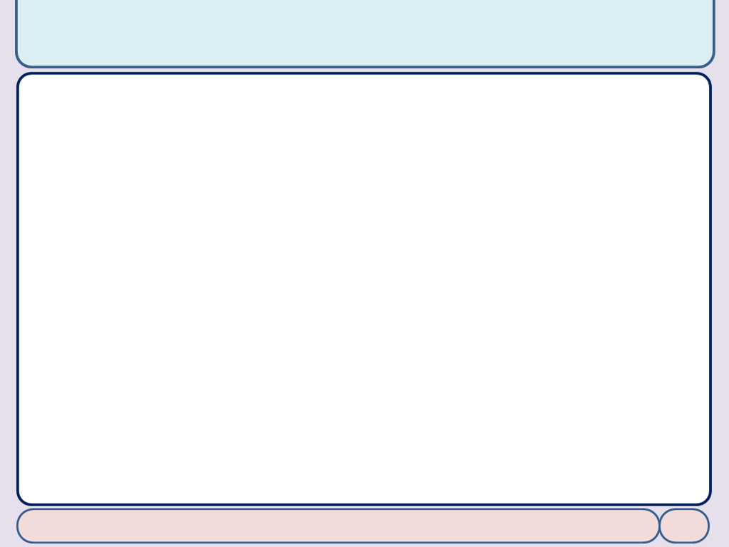
SUB Instruction
We have already seen MOV and ADD instr.
SUB Rd, Rn, Op2 ; Rd = Rn – Op2
A simple code
MOV R1, #0x34 ; load 0x34 into R1 (R1 = 0x34) SUB R5, R1, #0x25 ; R5 = R1 – 0x25 (R5 = 0x34 – 0x25)
Microprocessors and Assembly Language, Spring 2020, AUT, Tehran, Iran

Slide 6
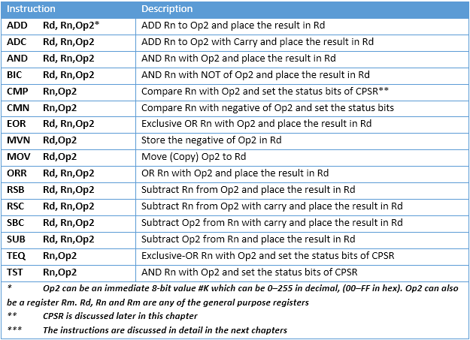
ALU Instructions Using GPRs
Microprocessors and Assembly Language, Spring 2020, AUT, Tehran, Iran

Slide 7
The ARM Memory Map
Memory space allocation in the ARM
4 gigabytes of directly accessible memory space
from 0 to 0xFFFFFFFF
Memory space can be divided into five sections
On-chip peripheral and I/O registers
On-chip data SRAM
On-chip EEPROM (for saving critical data)
On-chip Flash ROM (program space)
Off-chip DRAM space
Microprocessors and Assembly Language, Spring 2020, AUT, Tehran, Iran

Slide 8
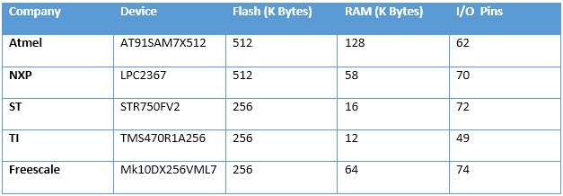

The ARM Memory Map
Why both EEPROM and Flash?
Why both SRAM and EEPROM?
IO-mapped or Memory-Mapped IO?
Memory space is 4GB; is it enough?
Microprocessors and Assembly Language, Spring 2020, AUT, Tehran, Iran

Slide 9
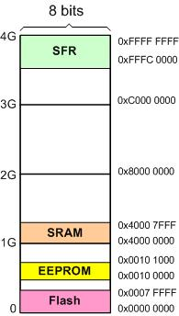
The ARM Memory Map
Q: A given ARM chip has the following address assignments. Calculate the space and the amount of memory given to each section.
(a) Address range of 0x00100000 – 0x00100FFF for EEPROM
(b) Address range of 0x40000000 – 0x40007FFF for SRAM
(c) Address range of 0x00000000 – 0x0007FFFF for Flash
(d) Address range of 0xFFFC0000 – 0xFFFFFFFF for peripherals
peripherals
Microprocessors and Assembly Language, Spring 2020, AUT, Tehran, Iran

